Slide 1
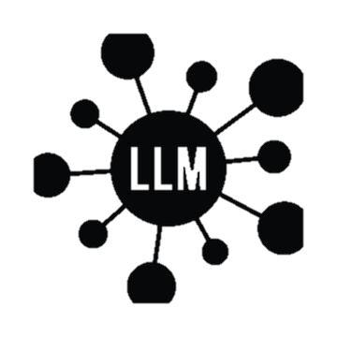
Conversational AI Asset Input & Feedback from DTT Americas Public + Industrial
Vision: Comprehensive conversational ai platform, plug and play asset components, simple and integrated implementation
Themes:
Integrated development: Dialog Design, Development, testing, and analytics are linked via automation, any cloud
Recurring Revenue by simplified offering: Voice, Text (web, SMS, Mobile app, email, etc…), CCaaS
AI capabilities of today and tomorrow: flexible architecture supports ML/Automation, Generative/RAG, Agentic frameworks
Feedback: Overuse of LLMs will overprice IBM against competitors, agentic is the future but too far ahead of the market to hit IBM asset signings and revenue goals for next 24-36 months.
Traditional AI/ML can handle 90% of use cases very well at a lower price point.
Gen/Agentic has latency challenges in voice channel. #1 Channel for client value and impact, as well as IBM revenue
Conversational Design
Conversational Platform
Orchestration, Analytics, Testing
Dialog flow designer – centralized tool to create consistent designs + guidance on best practices
Transformer: transform designs into (1) code input for developers (2) create test cases based on design
A conversational AI template using a mix of traditional conversational AI (action skills) + generative (RAG, agentic)
Templates/best practices to build in flexibility into design, avoid technical debt
Simple and easy to create Dashboards
Conversational AI Feedback:
Difficult to implement and maintain, significant labor costs
Data science expertise required
Custom report builds required
Limits effectiveness
Testing:
Automated regression integration
“test” button for Unit testing by devs
Agentic AI + LLM + Dialog Flows
Deployed anywhere (AWS, Azure, GCP, IBM Cloud, on prem)

